Slide 1
Insights and analysis of Crash statistics in Australia
MO
Driving is a daily necessity for most Australians. This inevitably leads to road crashes, which can sometimes be fatal. We want to investigate crash statistics in Australia to understand what factors lead to accidents.

Slide 2
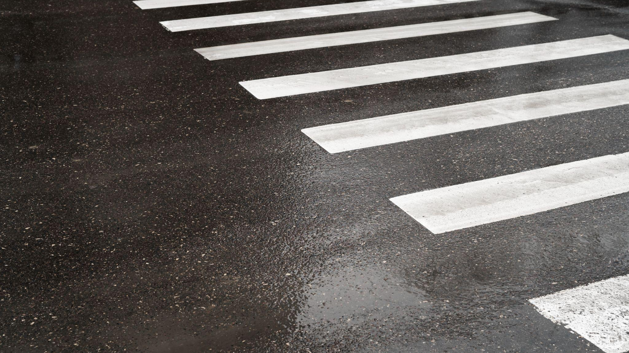
Questions to answer
01
02
03
04
CR
About the Dataset: The Australian Road Deaths Database provides basic details of road transport crash fatalities in Australia as reported by the police each month to the State and Territory road safety authorities.
Environment
Time period
Impacted road users
Which environment led to the most crashes?
During what time period did the most crashes occur?
Which road users were impacted by the crash?
05
Location
API
Which location had the most crashes?
Using an API what insight can we find?

Slide 3
Introducing the group
TD
Carolina Ramos
Ip, Hoi Kong (Roy)
Marianne O’Reilly
Theos Demetriou

Slide 4
Questions to answer
TD
What times led to the most fatal crashes?
What demographics lead to the most fatal crashes?
What road surface leads to the most crashes?
Which locations experienced the most crashes?

Slide 5
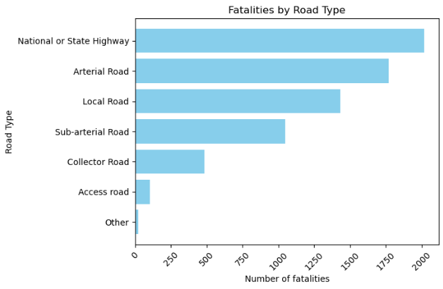
CR
1. What road type had the most fatalities?
Analysis and Insights:
The greater the risk profile of the road the greater the chance of a fatality. For example - a National Highway with a higher speed limit has a riskier profile and thus leads to more fatalities from crashes. • National or State Highway had the highest number of fatalities from crashes followed by Arterial Road and then Local Roads.

Slide 6
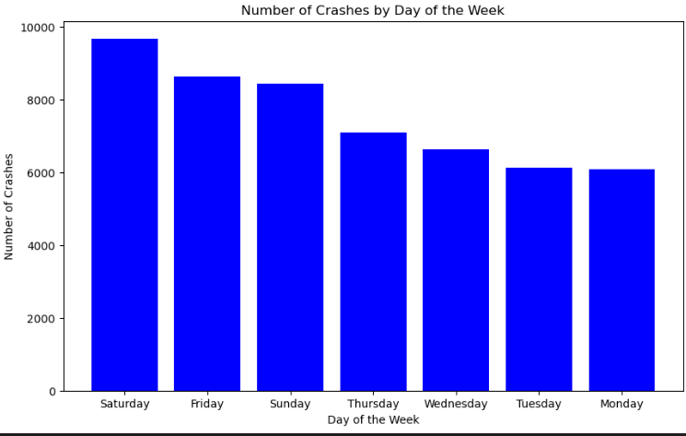
CR
2. What day of the week had the most fatalities from crashes?
Analysis and Insights:
The sheer volume of cars on the road significantly contributes to the increased accident risk during weekends.
Canadian statistics support our findings which indicate that Saturdays witness the highest number of cars on the road, followed by Fridays and Sundays.

Slide 7
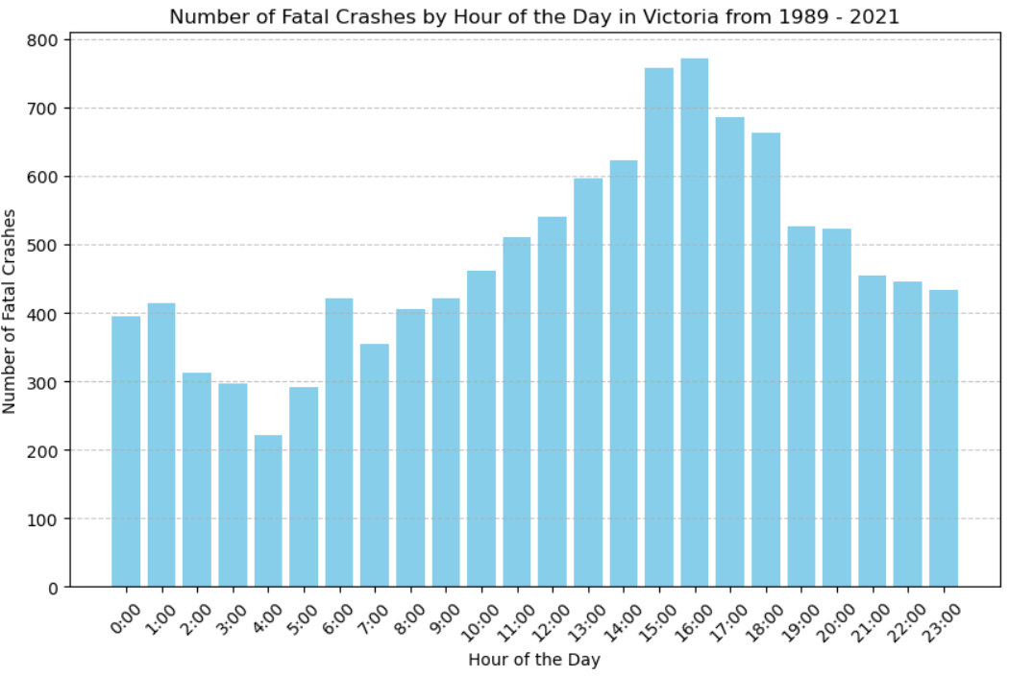
MO
3. What time of day leads to the most fatalities from crashes (Victoria only)?
Analysis and Insights:
The time of day with the most fatal crashes was 4pm and the time with the least fatalities was 4am.
Minimal fatal crashes in the early hours is likely due to less traffic with most people asleep. Fatal crashes rise slightly from 6:00 to 9:00 AM during the morning commute and spike significantly between 16:00 and 19:00, aligning with evening rush hour.

Slide 8
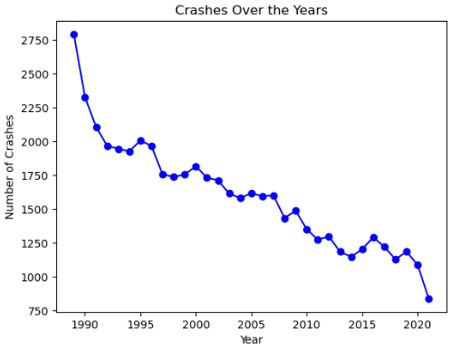
TD
4. Have the number of fatalities from crashes changed over time?
Analysis and Insights:
Overall fatalities from crashes have reduced over time.
There are a number of factors reducing the crashes over time:
Vehicle safety features including air bags and electronic stability control.
Inreased seat belt usage
Stricter law implementation on drugs and alcohol
Improvement in vehicle design
COVID led to less cars on the road in 2021

Slide 9
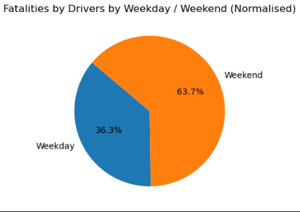
TD
5. Are there more fatal crashes on weekdays or weekends?
Analysis and Insights:
When the data was normalised for the number of days in weekdays and weekends, it was found that weekends contributed to more driver fatalities
Contributing factors were
Increased use of drugs and alcohol on weekends.
Increased motor vehicle usage by teenagers on weekends leading to higher deaths.
Increased drivers / cars on the road on weekend

Slide 10
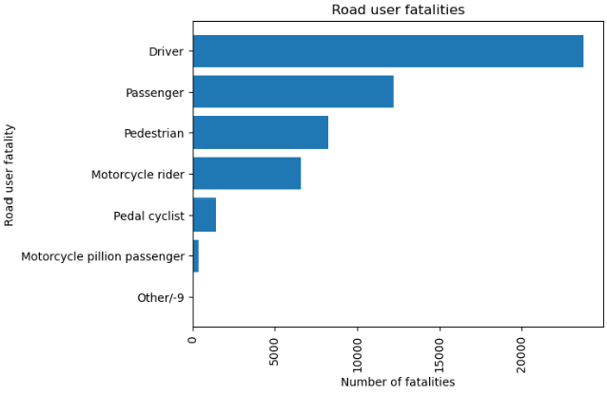
RI
6. Which road users were most impacted by crashes?
Analysis and Insights:
The road user which was most impacted by fatal crashes was the driver (45.1%) of all fatalities followed by the passenger (23.1%) and then by pedestrians (15.6%).

Slide 11
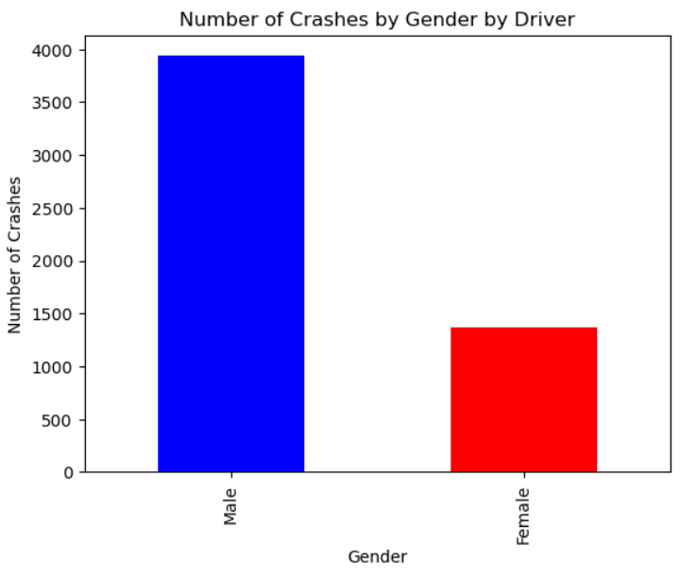
MO
7. In Victoria, which gender has the most fatal crashes?
Analysis and Insights:
There was a higher proportion of fatal crashes involving male drivers compared to female drivers. Male drivers are involved in almost three times as many fatal crashes as female drivers.
Factors affecting results:
1. Men might spend longer hours driving due to occupation.
2. Men may engage more in risky behaviour.
3. Gender norms may encourage men to drive more than women.

Slide 12
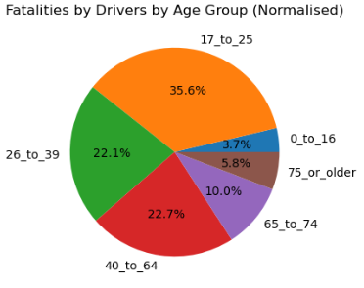
RI
8. Which driver age group causes the most fatalities?
Analysis and Insights
When the data was normalised it showed that the age group between ‘17 to 25’ accounted for more than one third of crashes. The next two largest respectively were ‘26 to 39’ and ‘40 to 64’ age groups. Younger age groups are more prone to speeding except for the ‘0 to 16 age group’ who supervised whilst on learners permits.

Slide 13
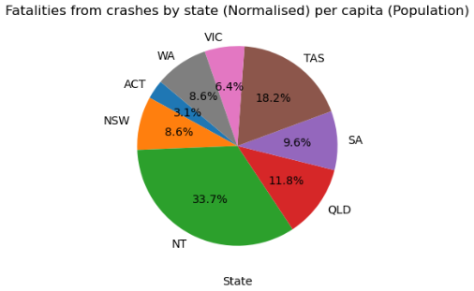
RI
9. Which state has the most fatalities per capita (population)?
Analysis and Insights
Using an API to derive the population of the state and territorries of Australia. It was found that Northern Territory had the highest proportion of fatalities from crashes on a per capita basis.
NSW and VIC had the highest number of fatal crashes but when normalised the proportion was lower per capita.

Slide 14
Resources
RI
Links to where we obtained our resources
Are women safer than men?
https://www.greenslips.com.au/blog/are-women-safer-drivers-than-men.html#:~:text=Women%20make%20up%20half%20of,female%20and%2077.3%25%20were%20male.
Why majority of accidents happen on the weekend
https://clginjurylaw.ca/why-majority-of-auto-accidents-happen-on-weekends/#:~:text=The%20sheer%20volume%20of%20cars,followed%20by%20Fridays%20and%20Sundays.

Slide 15
TD
“Drive as if every child on the street were your own. Because in someone's eyes, they are.”

Slide 16
Questions to answer
01
02
03
04
TD
Environment
Time period
Impacted road users
Which environment led to the most crashes?
During what time period did the most crashes occur?
Which road users were impacted by the crash?
05
Appendices -
Coding
Location
API
Which location had the most crashes?
Using an API what insight can we find?

Slide 17
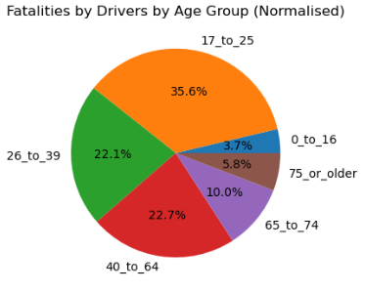
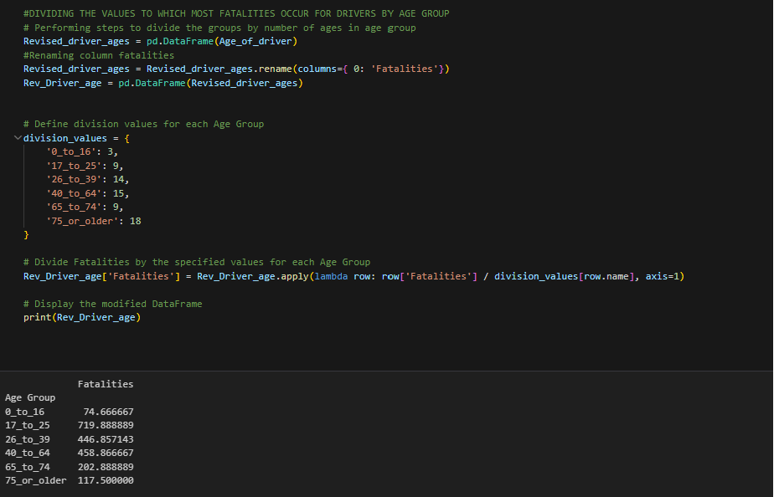
RI

Slide 18
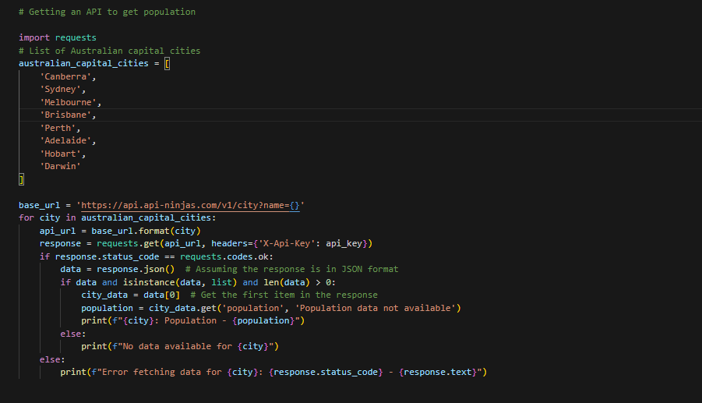
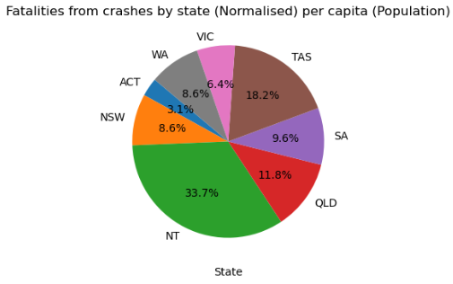
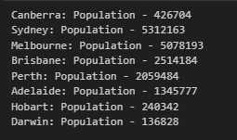
TD

Slide 19
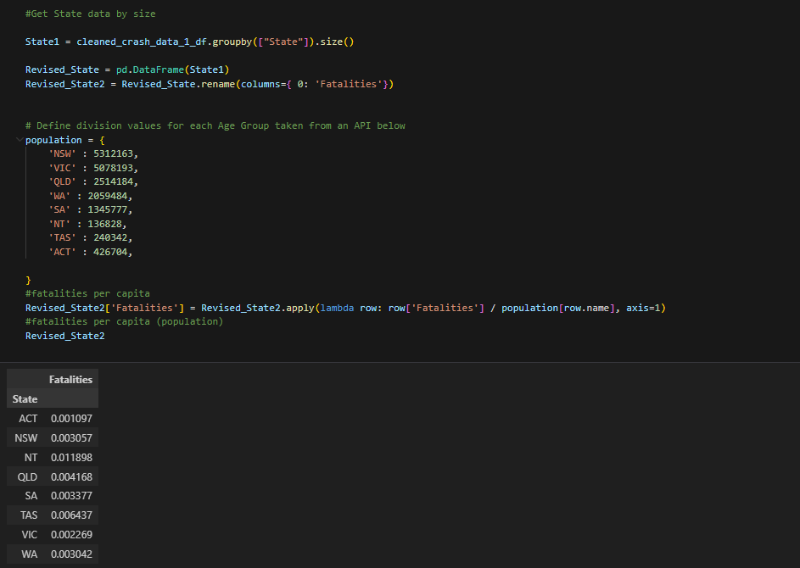
TD

Slide 20
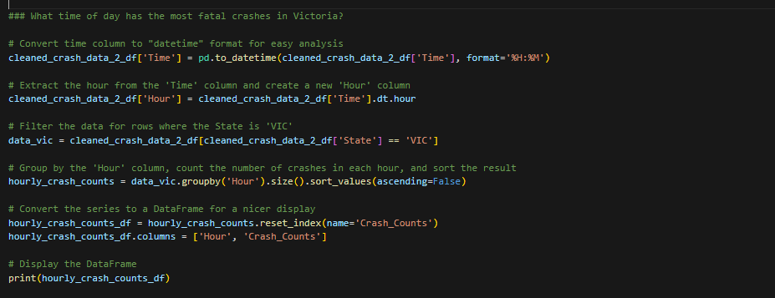

MO

Slide 21
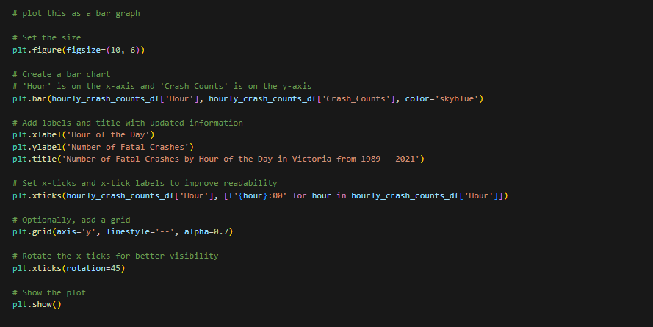
MO

Slide 22
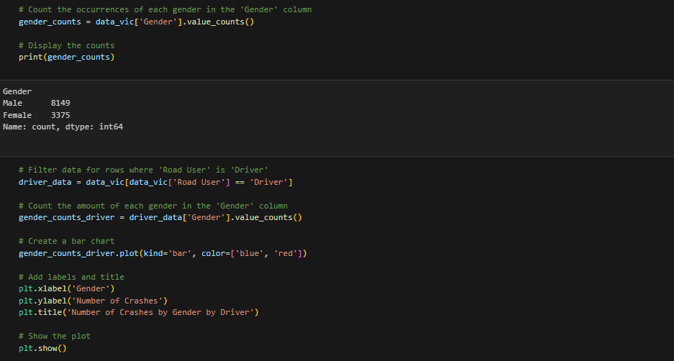
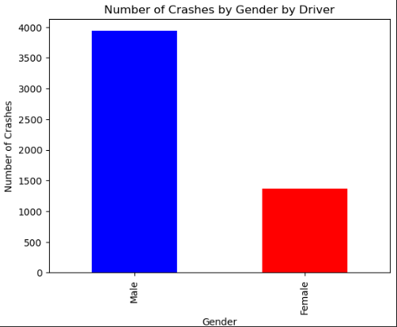
CR

Slide 23
Questions to answer
01
02
03
04
CR
Environment
Time period
Impacted road users
Which environment led to the most crashes?
During what time period did the most crashes occur?
Which road users were impacted by the crash?
05
THANK YOU
Location
API
Which location had the most crashes?
Using an API what insight can we find?

